Slide 1
CAPSTONE PROJECT - 2
SUBMITTED BY :- AKANKSHA SINGH , PGA 23
PROJECT TITLE : Predict a species of a penguin based on physical attributes.

Slide 2
ABSTRACT : The goal of this project is to analyse the given data on penguins and predict whether a particular penguin specie will appear at the most favourable point based on the physical attributes. The data was divided into 2 parts i.e. the training dataset and the testing dataset.

Slide 3
Models were developed on the training dataset and tested on testing dataset to find out the accuracy of each model based on the predicted values generated. Based on these models , we can determine how good a particular model is for the prediction .
Table of content
Introduction
summary of data
Transforming data
data standardization
Data visualization
Steps Performed
Results
conclusion

Slide 4
We will be using the same dataset through our discussions on classification with tree-methods (Decision Tree,Random Forests, Logistic Regression and Naive Bayes) in order to compare performance metrics across these related models.
We will work with the "Palmer Penguins" dataset, as it is simple enough to help us fully understand how changing hyperparameters can change classification results.
ImageData were collected and made available by Dr. Kristen Gorman and the Palmer Station, Antarctica LTER, a member of the Long Term Ecological Research Network.
Summary: The data folder contains CSV file. For intro courses/examples, we are going to use the (penguins_size.csv).
penguins_size.csv: Simplified data from original penguin data sets. Contains variables:
species: penguin species (Chinstrap, Adélie, or Gentoo)culmen_length_mm: culmen length (mm)culmen_depth_mm: culmen depth (mm)flipper_length_mm: flipper length (mm)body_mass_g: body mass (g)island: island name (Dream, Torgersen, or Biscoe) in the Palmer Archipelago (Antarctica)sex: penguin sex(Not used) penguins_lter.csv: Original combined data for 3 penguin species

Slide 5
Note: The culmen is "the upper ridge of a bird's beak“
Treating with missing data , we found that there are missing values which has to be treated to get good accuracy and results.
If we are simply dropping rows which have missing value, we end up with 334 entries out of original 344. 10 rows are gone.
after quick analysis we dropped 2.90% of data , to treat these missing values and good reliable model can be build

Slide 6
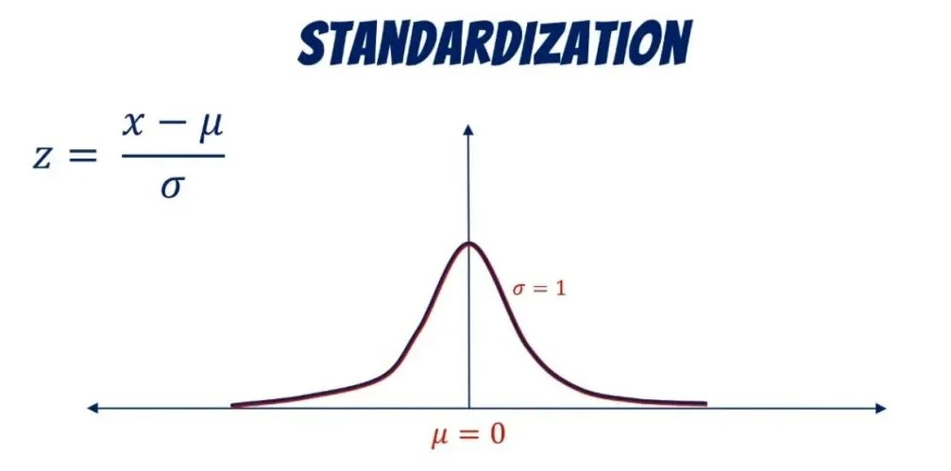
Data Standardization:
It is a process in which data attributes within a data model are organised to increase the cohesion of entity types.
Data visualization
It is the process of representing data using visual elements like lines, points, and bars. It's a key step in data analysis and helps people understand and interact with data.

Slide 7
In this project we have used many visualization techniques to represent the findings and analyses in a very easy manner
visualizations like : Pairplot , barplot , box plot , catplot , scatter plot , lineplot are used for better and quick understanding
From the very first visualization , we can conclude that the highest number of species population in dataset is of ADELIE following with GENTOO then at last CHINSTRAP specie.
After that , coming to the next variable i.e island , firstly treating with null values of island and plotting the bar graph we came to that the maximum species lived on BISCOE ISLAND , following with DREAM ISLAND and with the least i.e TORGERSEN ISLAND.

Slide 8
We also found out that there is a very less difference between male and female population , Male population is 168 and female is 165 .
Comparing with FEMALE , MALE Group values:when we compare the data we can check for mean, min, max values for each features against each groupand deduct which sex group this missing row can be.
After comparing the values against with each group, we decided to choose to set it as "FEMALE“
Pairplot : A pair plot, also known as a scatterplot matrix, is a graph that shows the relationships between variables in a dataset. It's a key tool for data visualization and exploratory data analysis (EDA) in machine learning.

Slide 9
After building the catplot , we got to know that the culmen length of Adelie is far small than the other 2 species , while the other two i.e Chinstrap and Gentoo has approximately same culmen length whether male or female.
The scatter plot shows us the relationship between culmen length and culmen depth .
The culmen depth of Gentoo is found to be highest following with chinstrap and adelie.

Slide 10
Now lets come to Feature Engineering
Encoding As we have some of the features as categorical values (island, sex) we want to encode those values.we can leave species label as string value.
We have to split data into 2 parts
training and testing
in which training percentage of data is 70% and testing is 30%
importing some crucial libraries for the execution like Decision tree classifier
train test split
confusion matrix , classification report

Slide 11
After the first evaluation , the classification report gives the accuracy of 96%
now doing feature importance
after calculating this , we got to know that the flipper length has the most important features as per the values
So why features like body_mass_g and island_Torgersen are not being considered as important?It is because of the hyperparmeters that model is using to contruct the tree. In our case none was given.So often it is not even considering every features, unless we really push Decision Tree try to use every features. But we also need to take note that this may lead to overfitting.
To understand what is acutally happening insides the tree, we can visualize it.
we can see that X[2] is the base node, where index 2 of our dataset is flipper lenght mm.That's why it got considered as the most important feature.

Slide 12
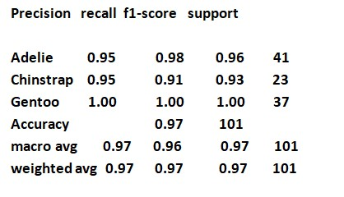
Visualize the Tree
filled: to be more visually appealinggini: gini impuritysamples: number of samplesvalue: label of each categories (in our case there are 3 penguin species)
Reporting Model ResultsTo make it easier to report in the future, we will create a new function.

Slide 13
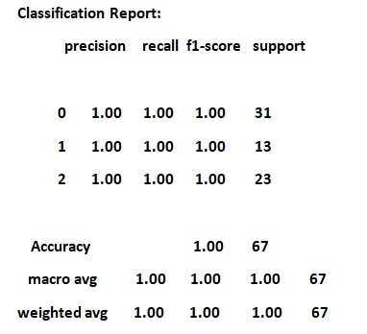
model 2
logistic regression

Slide 14
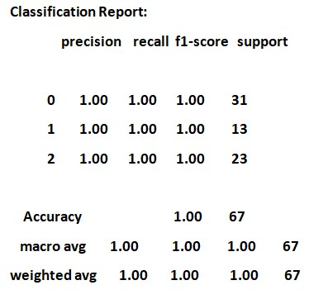
model 3
random forest
model 4
naive bayes
Accuracy: 98.02%

Slide 15
In the last we can conclude that
decision tree has the accuracy of 97%
logistic regression accuracy is of 100%
randomforest also has the accuracy of 100%
naive bayes has good accuracy of 98%
In all the cases the accuracies are quite high and reliable but the best are logistic regression and random forest in case of this dataset

Slide 16
Thank You

